Slide 1
Sweet Corn Silk Flies
Vegetable and Specialty Crop Expo
August 14, 2019
North Fort Myers, FL
Julien Beuzelin
Everglades Research and Education Center

Slide 2
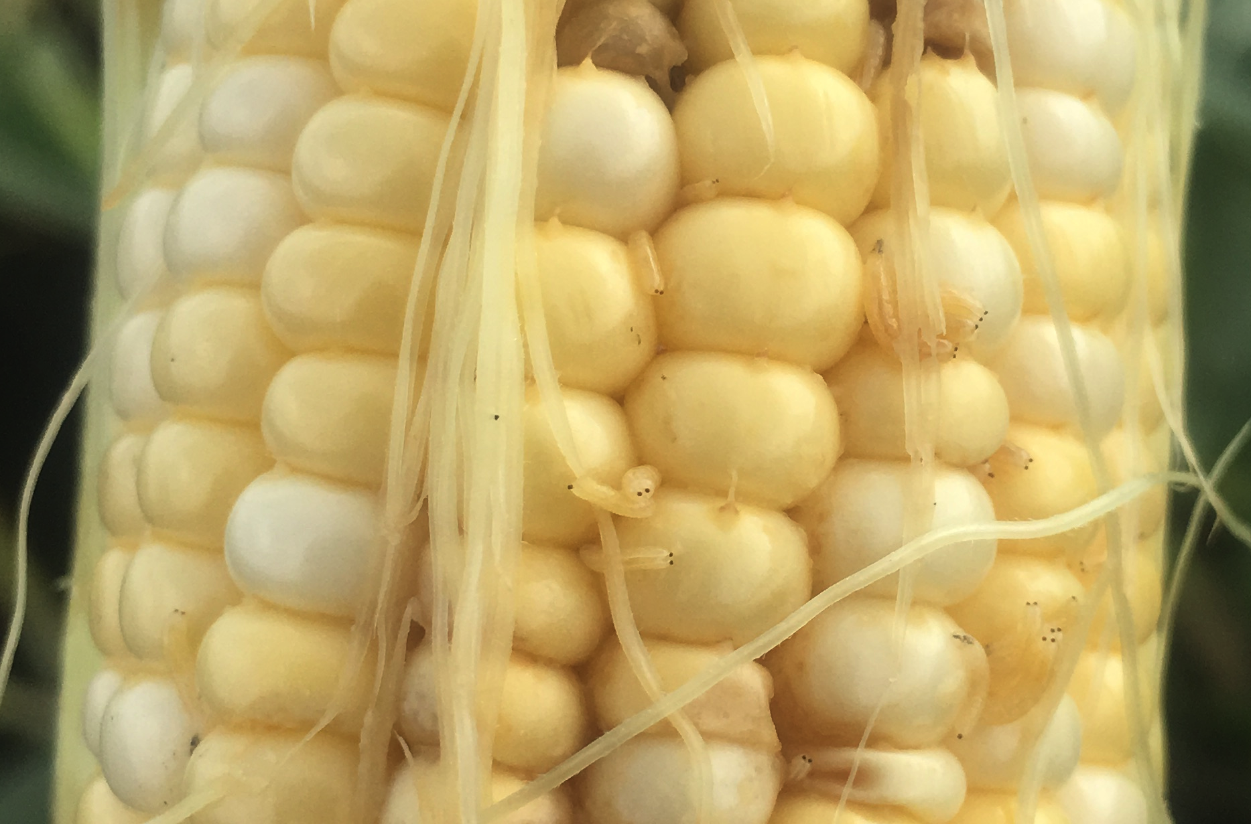

Slide 3
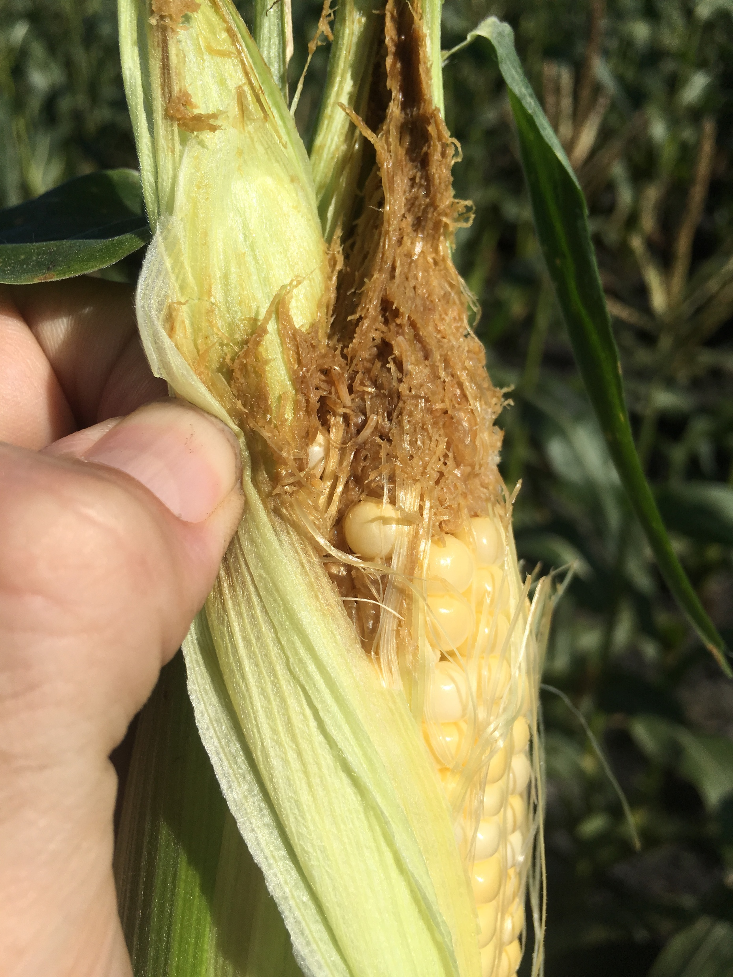

Slide 4
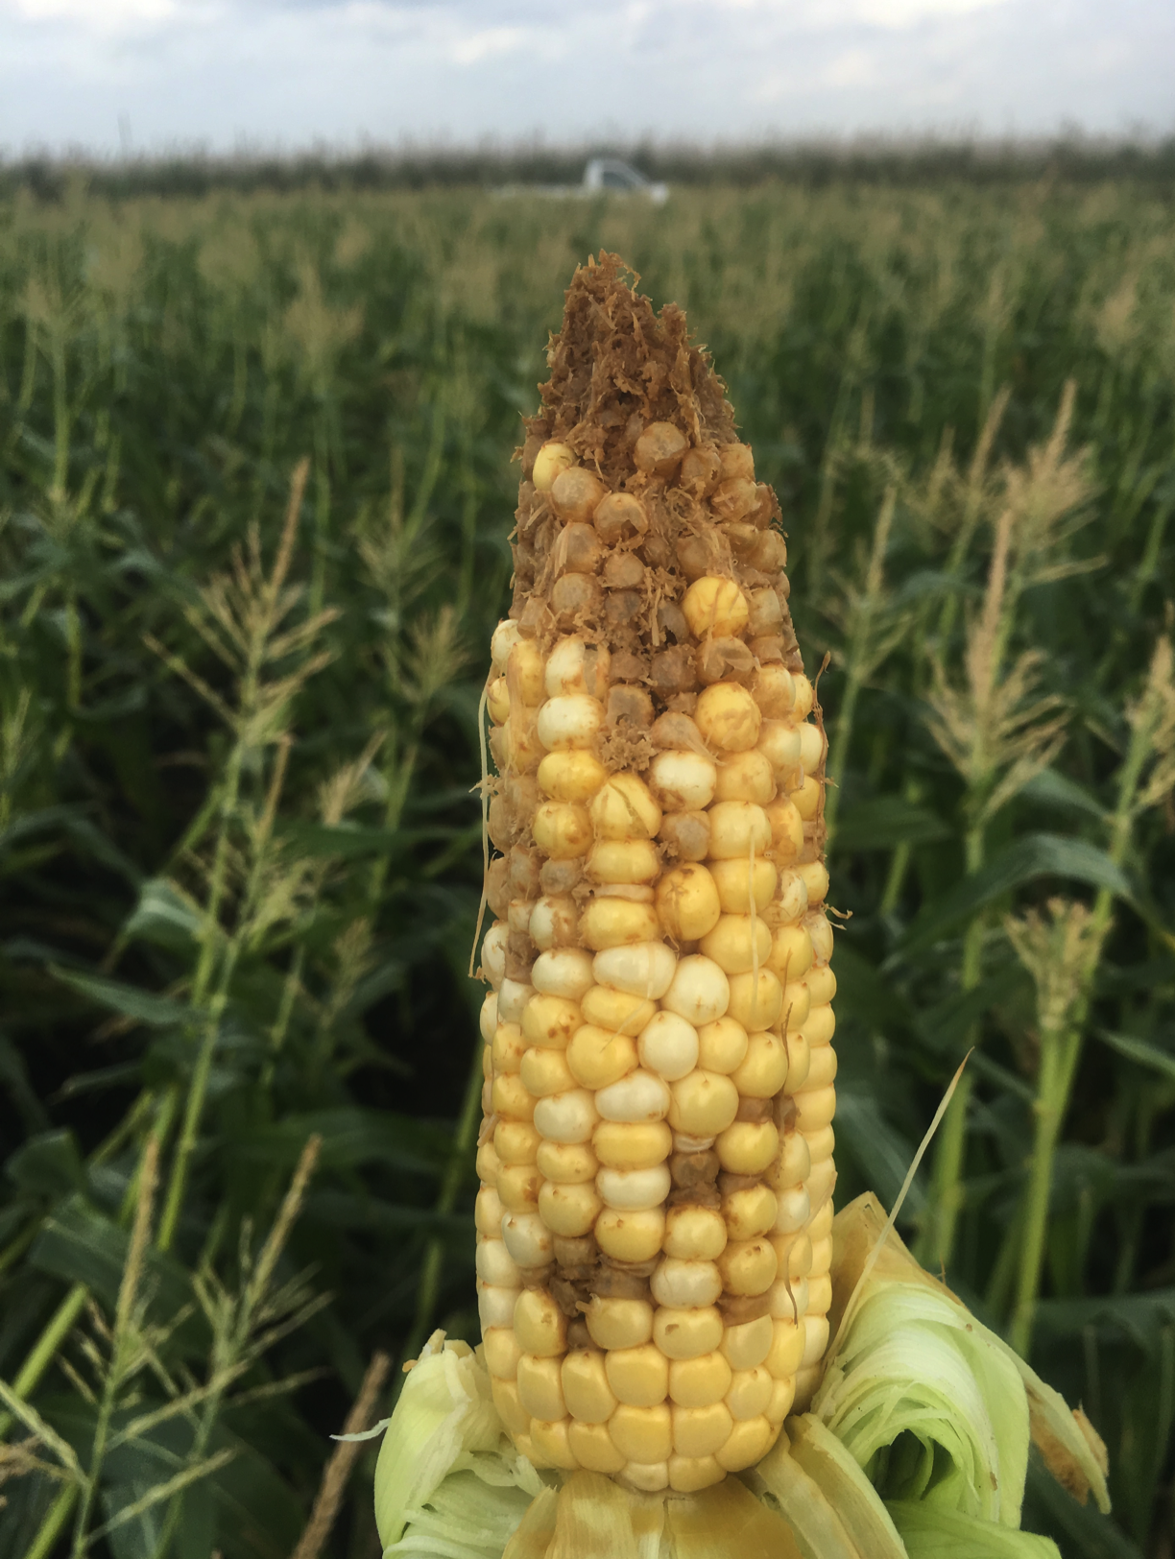

Slide 5
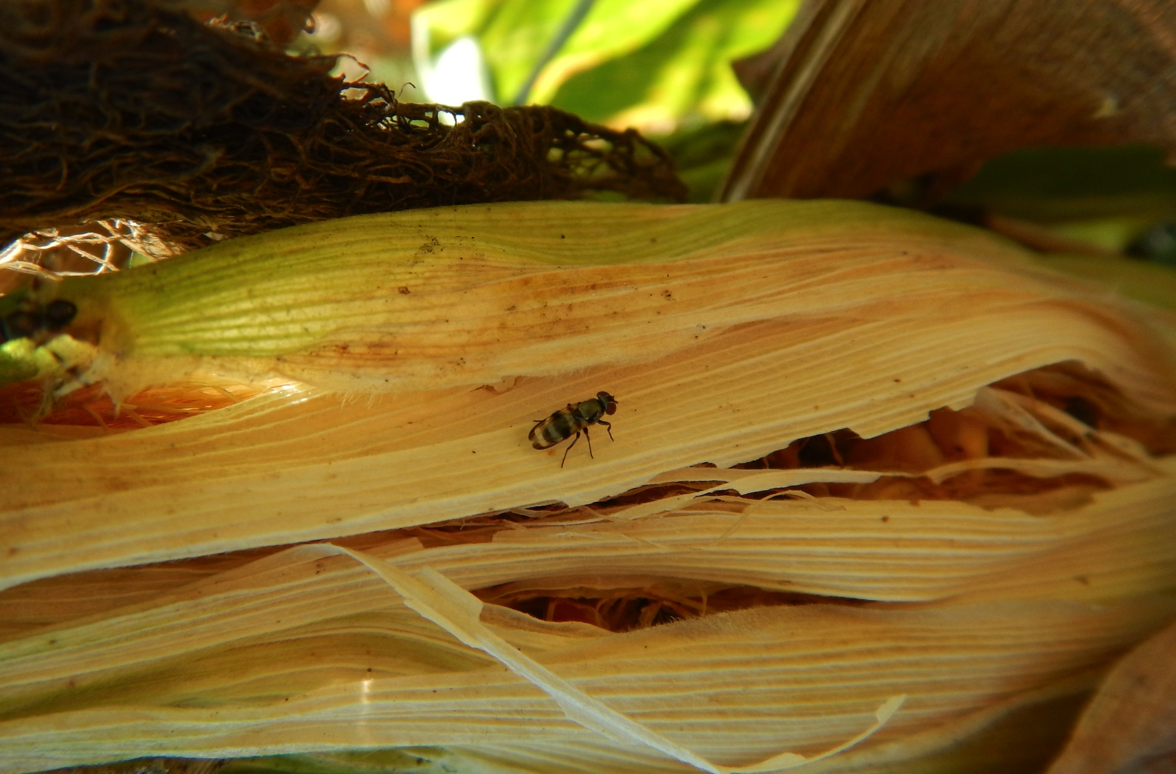
Euxesta stigmatias

Slide 6
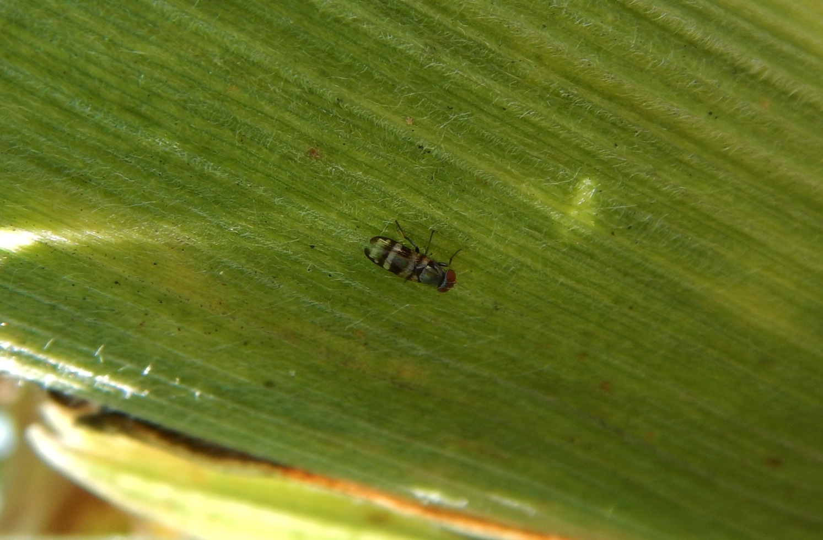
Euxesta eluta

Slide 7
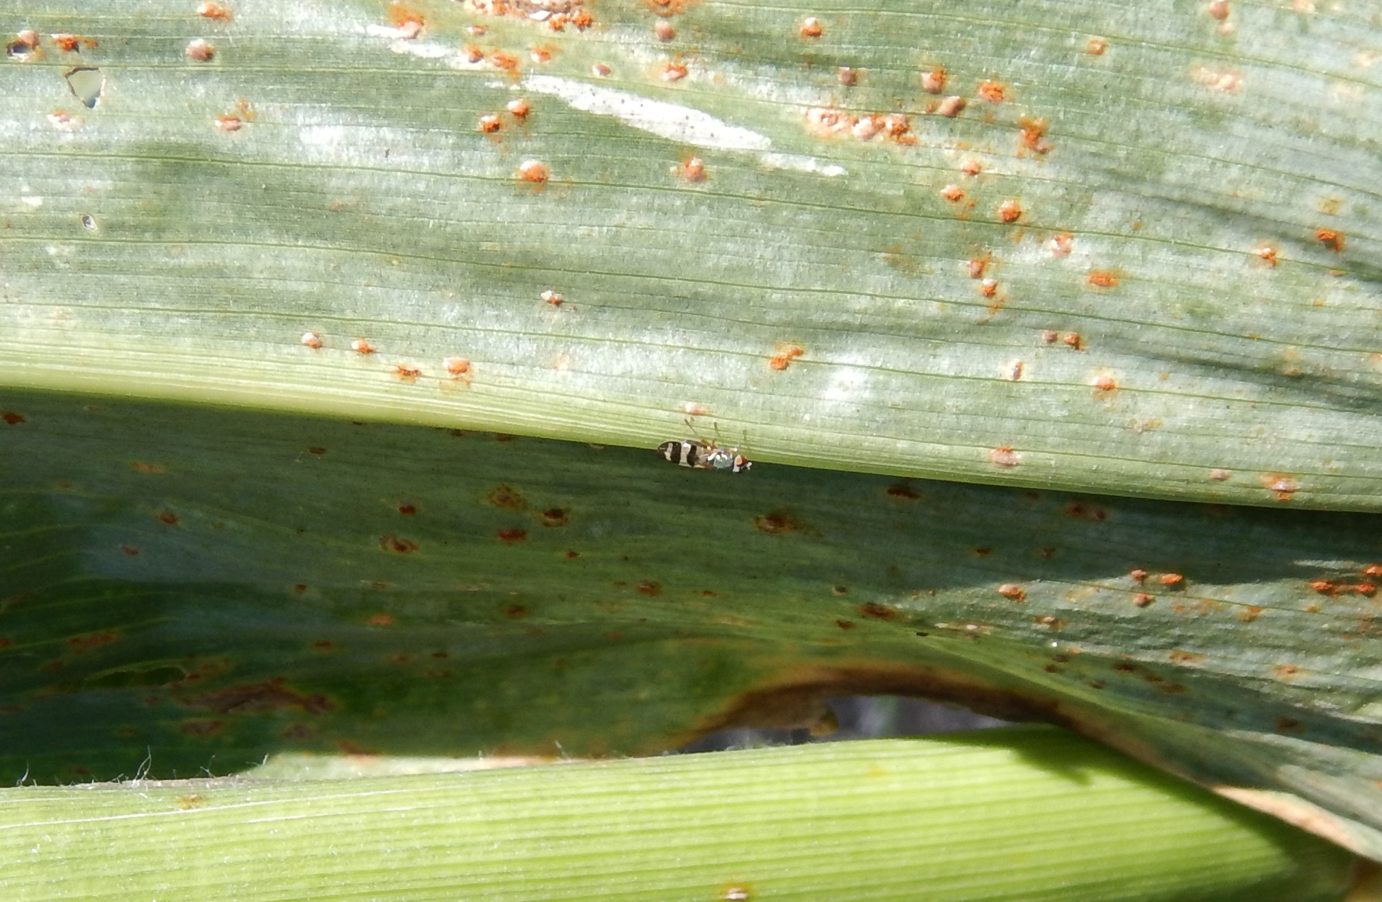
Chaetopsis massyla

Slide 8
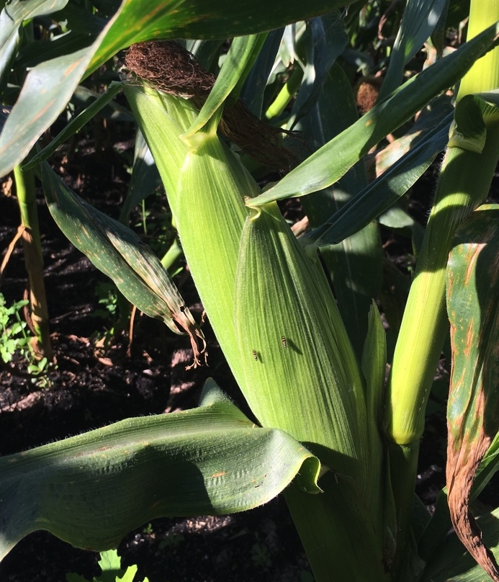
Eggs
Adults
Maggots
Pupae
(soil)

Slide 9
Cultural practices for silk fly management
Avoid late spring planting in problematic fields
Avoid weedy fields and borders
Avoid decaying crop residue, cull piles
Consider prompt sweet corn crop residue destruction, flooding
- Silk fly adults emerge from standing, harvested fields for >4-5 weeks
- Max. emergence of >700 adults/sq. ft in a day
Owens et al. 2017. Fla. Entomol. 100: 422-425.

Slide 10
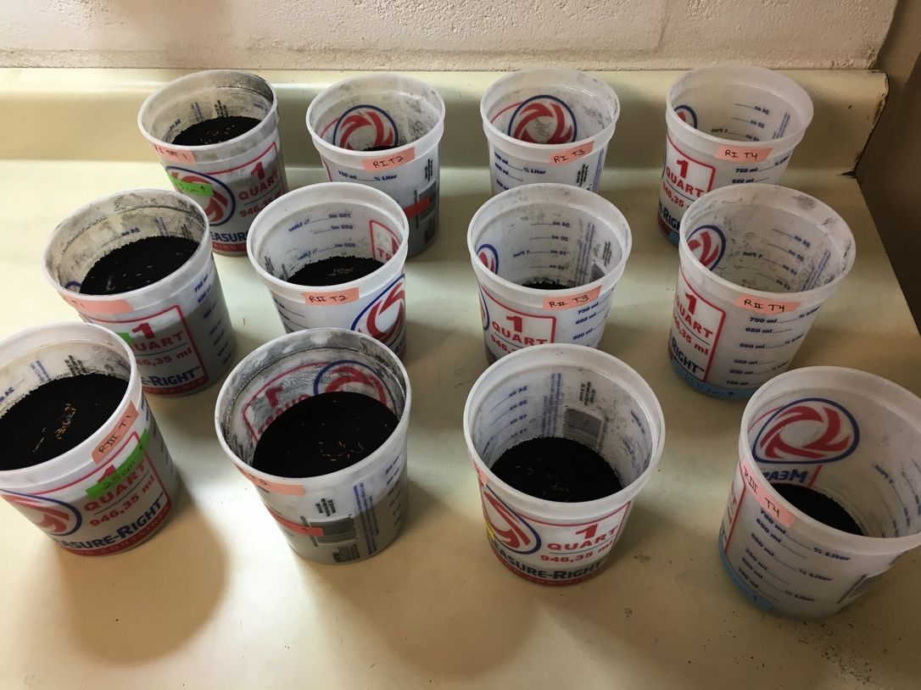
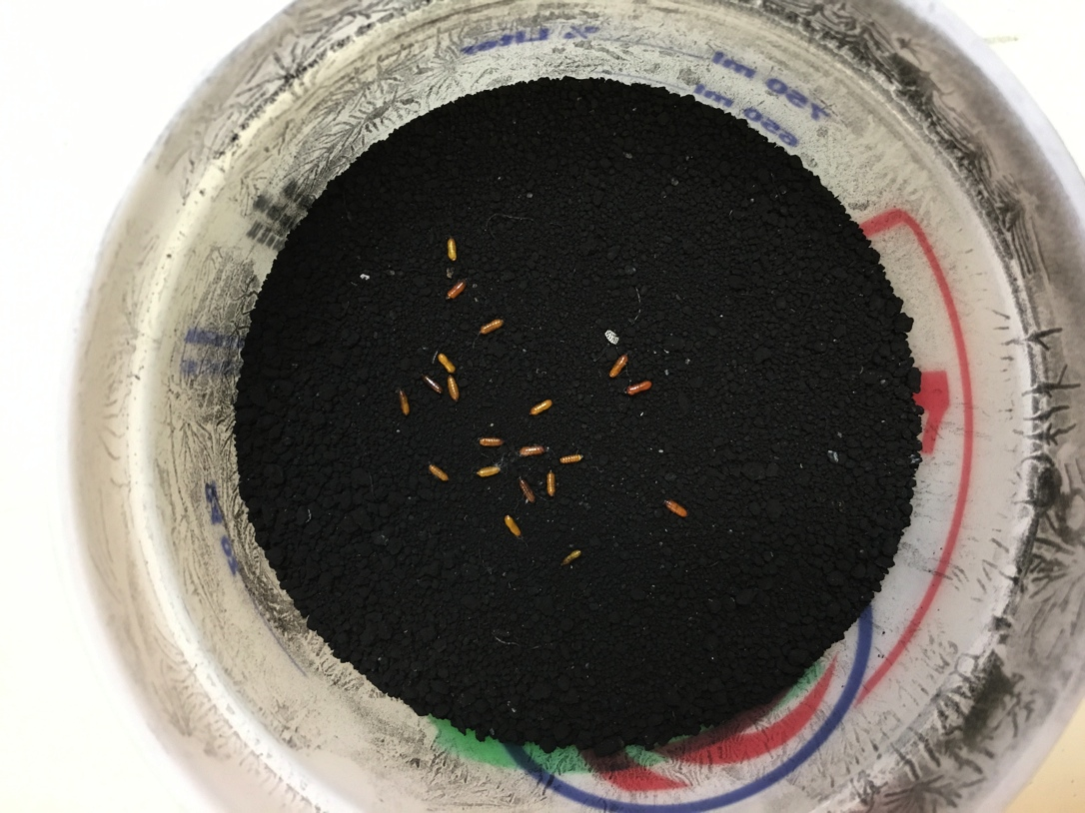
Silk fly-soil interaction laboratory studies
1-quart plastic buckets
20 E. eluta pupae / bucket

Slide 11
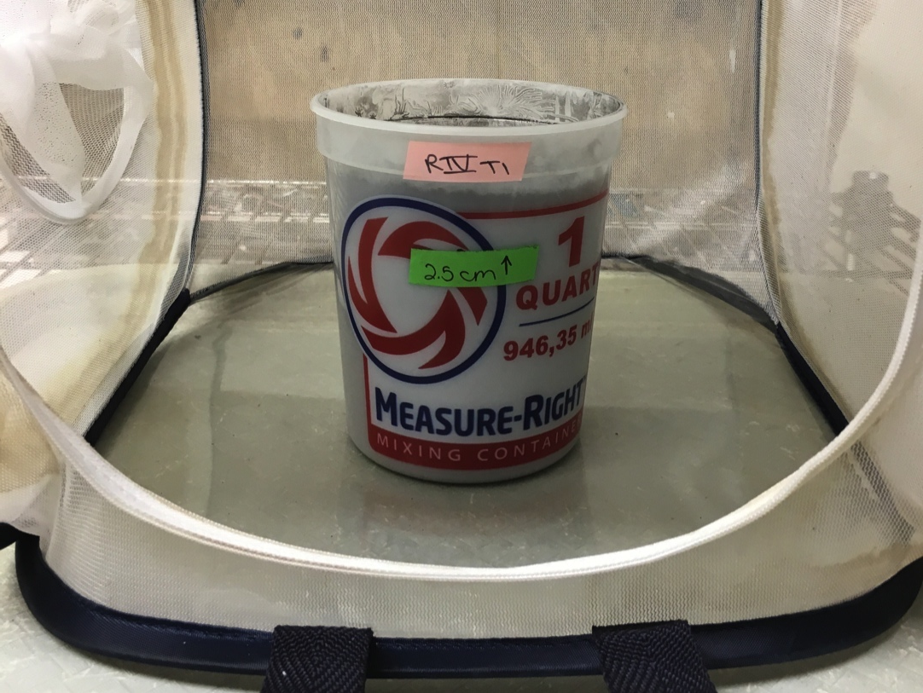
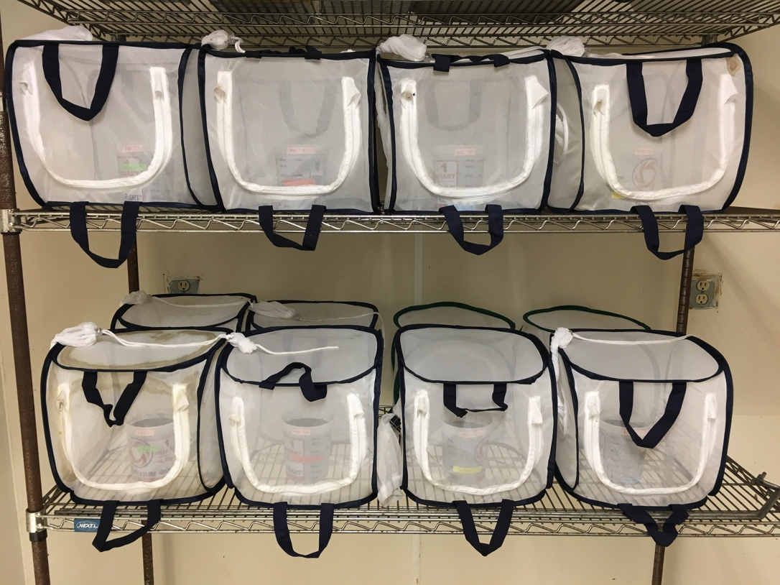
Silk fly-soil interaction laboratory studies
Buckets were individually placed into screen cages

Slide 12
Adult emergence as affected by the depth of pupae in organic soil
a
a
b
b
(1”)
(2”)
(3”)
(4”)
Linear mixed model (SAS PROC GLIMMIX): Bars with the same letter are not different (P > 0.05)

Slide 13
Adult emergence as affected by flooding in organic soil
a
ab
bc
c
Linear mixed model (SAS PROC GLIMMIX): Bars with the same letter are not different (P > 0.05)

Slide 14
Sweet corn
Insecticides for silk fly management
Frequent pyrethroid applications between first silk and harvest (target adults)
- zeta-cypermethrin (Mustang) has worked best
- lambda-cyhalothrin (Warrior, Silencer, etc.)
- beta-cyfluthrin (Baythroid), esfenvalerate (Asana) have been relatively less effective
Consider ground applications, relatively high spray volumes, and surfactant use to increase coverage

Slide 15
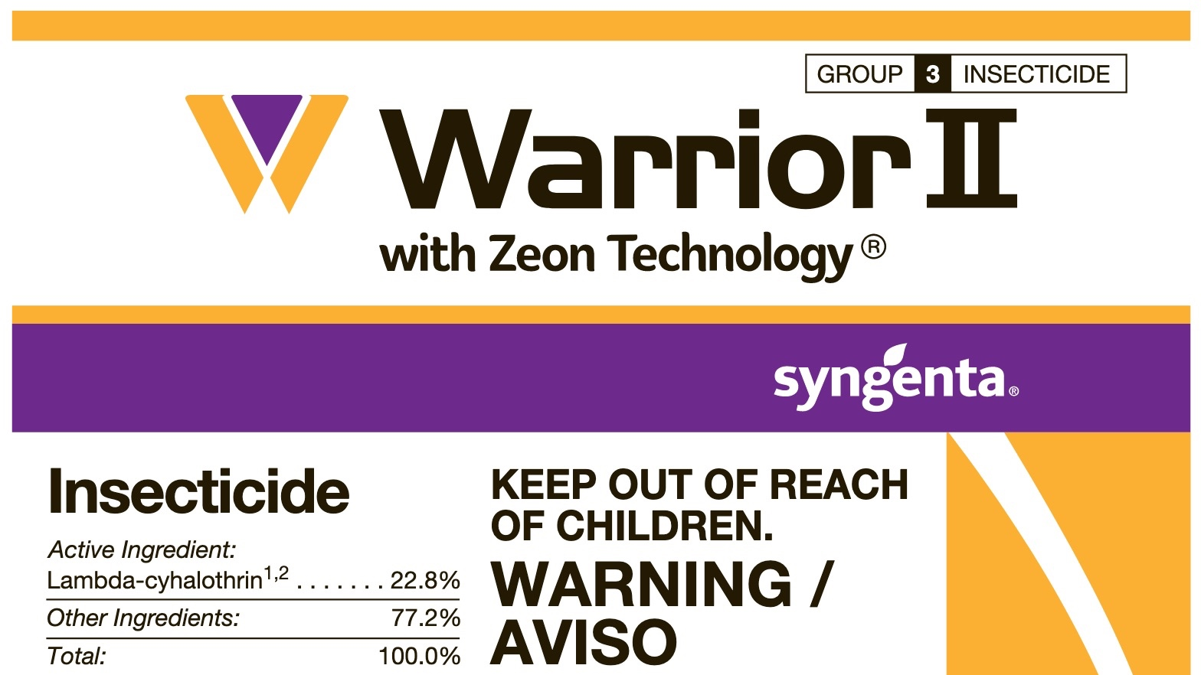
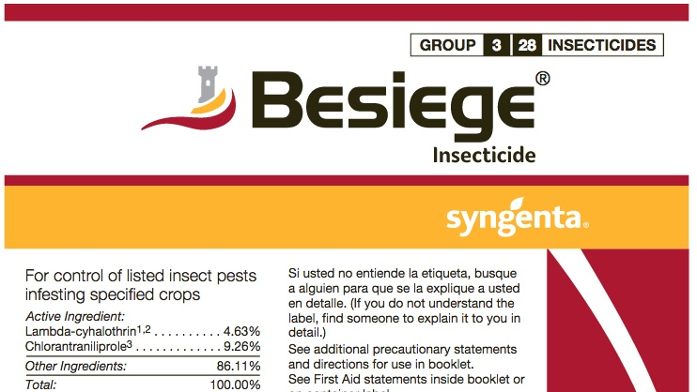
Group 3
=
Pyrethroid

Slide 16
Sweet corn
Consider the addition of PBO
PBO (piperonyl butoxide), a synergist to increases silk fly susceptibility to pyrethroids
 |  |  | Increase in susceptibility
E. stigmatias | 187 | 60 | 3.1-fold
E. eluta | 23 | 14 | 1.7-fold
C. massyla | 48 | 7 | 6.5-fold
LC₅₀ is the insecticide concentration killing 50% of the population
Owens et al. 2016. J. Econ. Entomol. 109: 1283-1288.

Slide 17
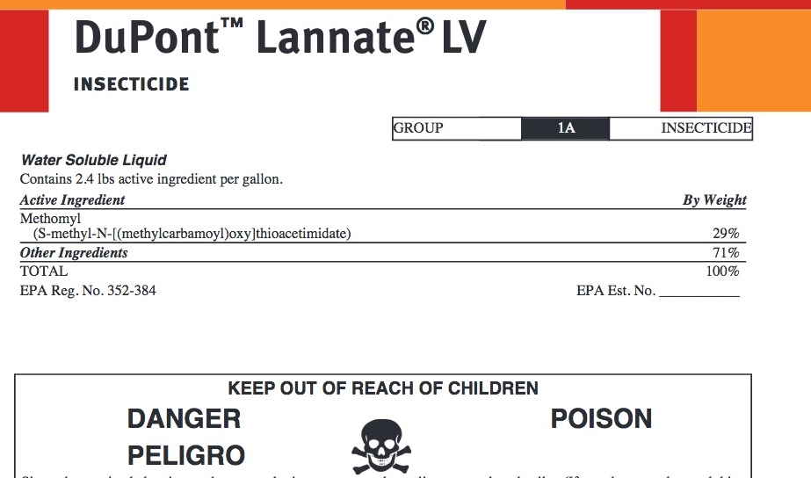
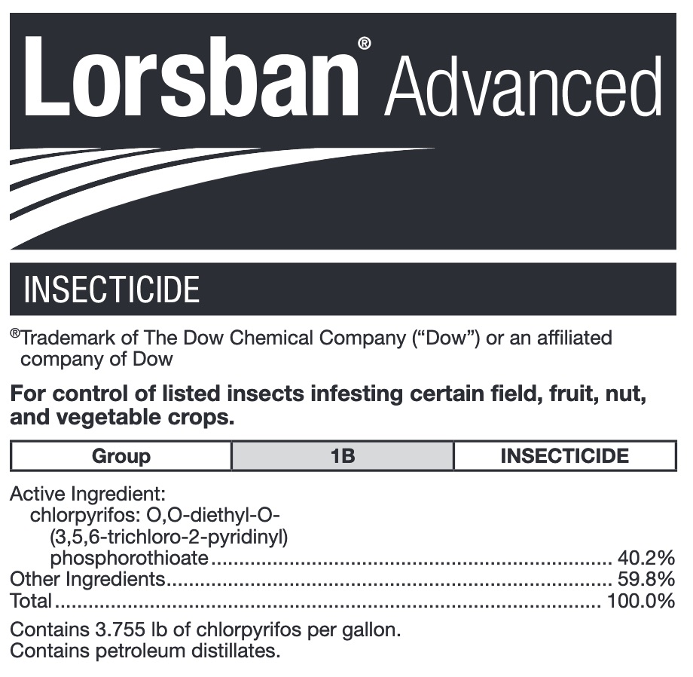
Consider the use of other insecticides

Slide 18
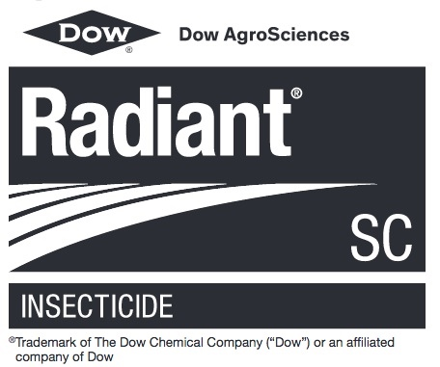
Consider the use of other insecticides

Slide 19
Silk fly insecticide efficacy, 2017
a
a
ab
ab
abc
bc
bc
bc
bc
bc
c
c
Bars with the same letter are not different (P > 0.05)

Slide 20
Sweet corn
Corn silk fly management in Florida
Pyrethroid applications 3, 4, or 7 times / week between first silk and harvest are common
- Management failures and load rejections occur
Need to improve corn silk fly management with pyrethroids
Can time of the day for an application have an effect on pyrethroid efficacy?

Slide 21
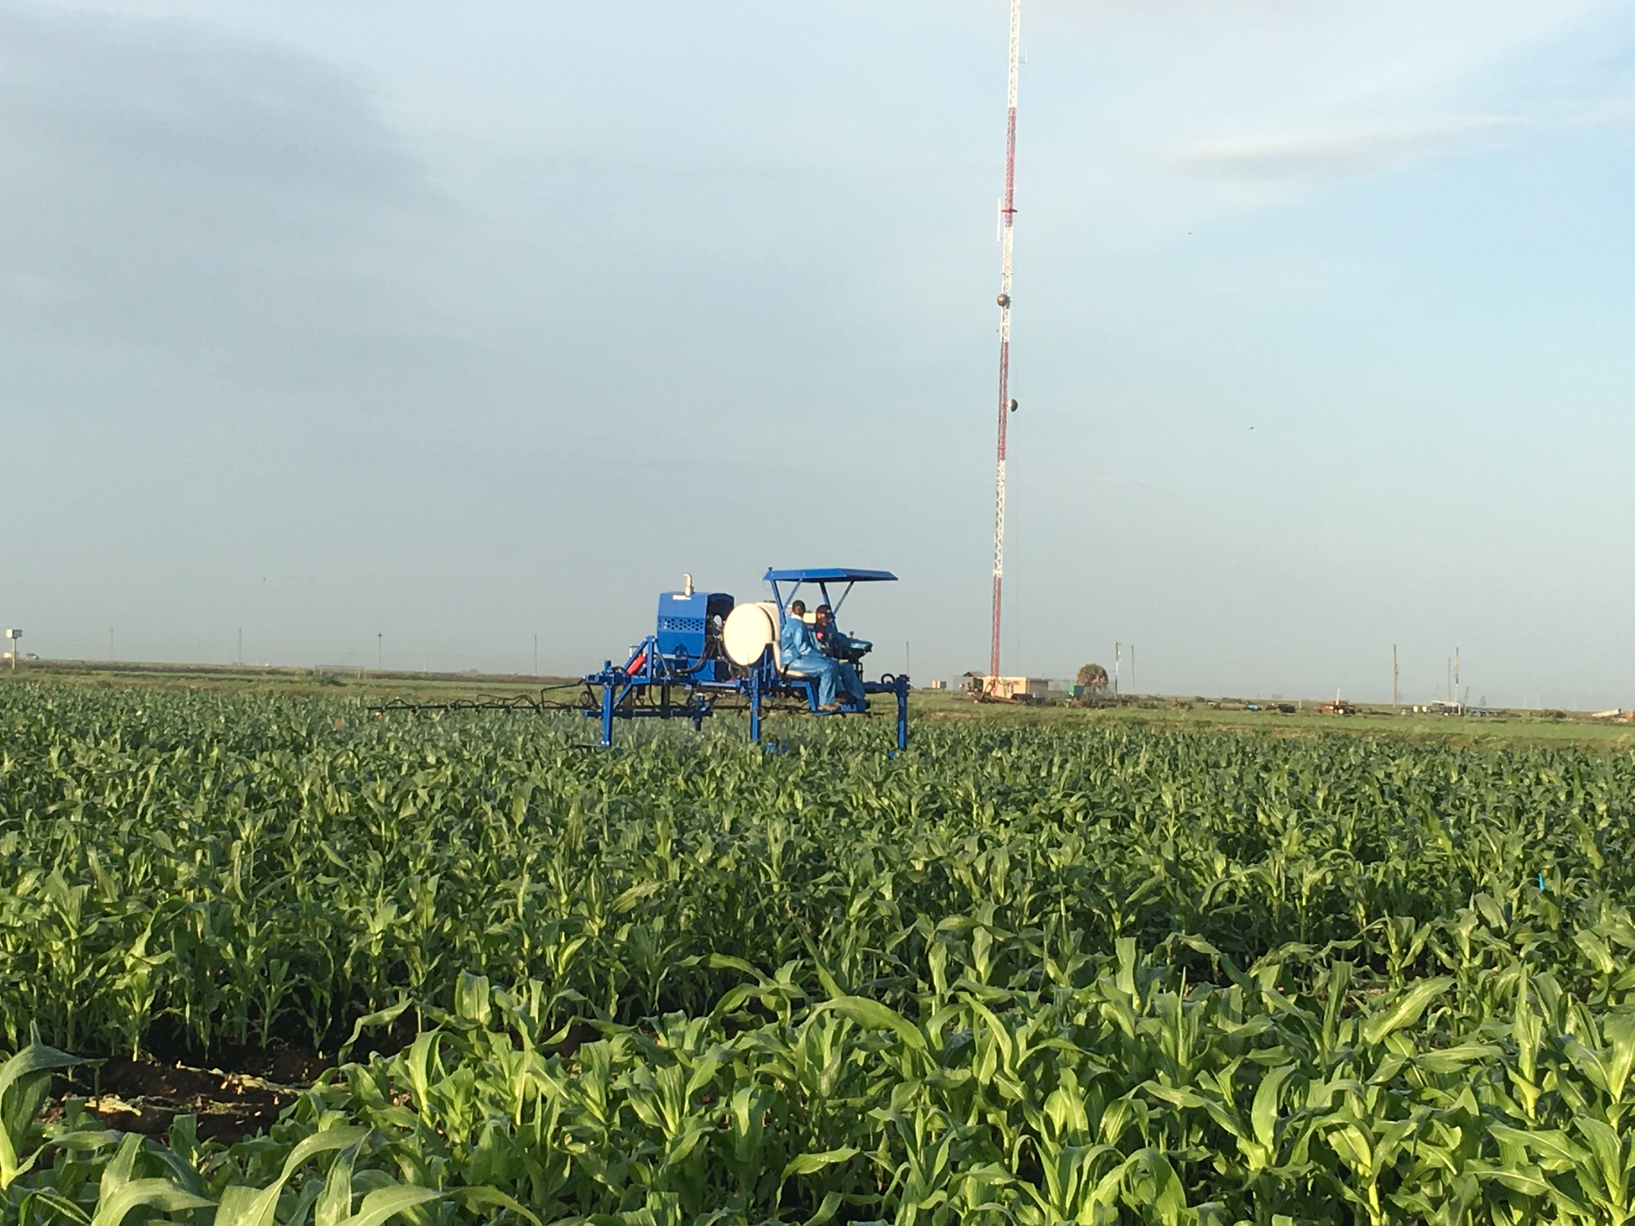
Effect of pyrethroid application timing
on silk fly injury and infestation levels
Early AM, early PM, late PM, non-treated
- 50’ by 50’ plots, 6 replications
- 3 pyrethroid applications / week for 3 weeks
- 10 GPA at 30 PSI

Slide 22
Effect of pyrethroid application timing on silk fly injury and infestation levels
 | Ear injury rating | % ear area injured | No. maggots /ear
Early AM | 2.4b | 1.3b | 4.5b
Early PM | 1.8bc | 0.9b | 3.3b
Late PM | 1.7c | 0.9b | 3.3b
Non-treated | 3.4a | 5.8a | 13.5a
F | 28.2 | 7.9 | 5.9
df | 3, 15 | 3, 15 | 3, 15
P > F | <0.001 | 0.002 | 0.007
Means in a column followed by the same letter are not different (Tukey-Kramer adjustment, α = 0.05 )
Notes:
50 ears / plot

Slide 23
Sweet corn
Corn silk fly management in Florida
Scouting, no formal action threshold
- Direct observations in the field
- Decision based primarily on adult presence
- 3 fly species considered equivalent
Need for a more consistent sampling method allowing species identification
- Adults are relatively small, highly mobile
Can traps baited with synthetic lures be used to monitor silk fly adult populations?

Slide 24
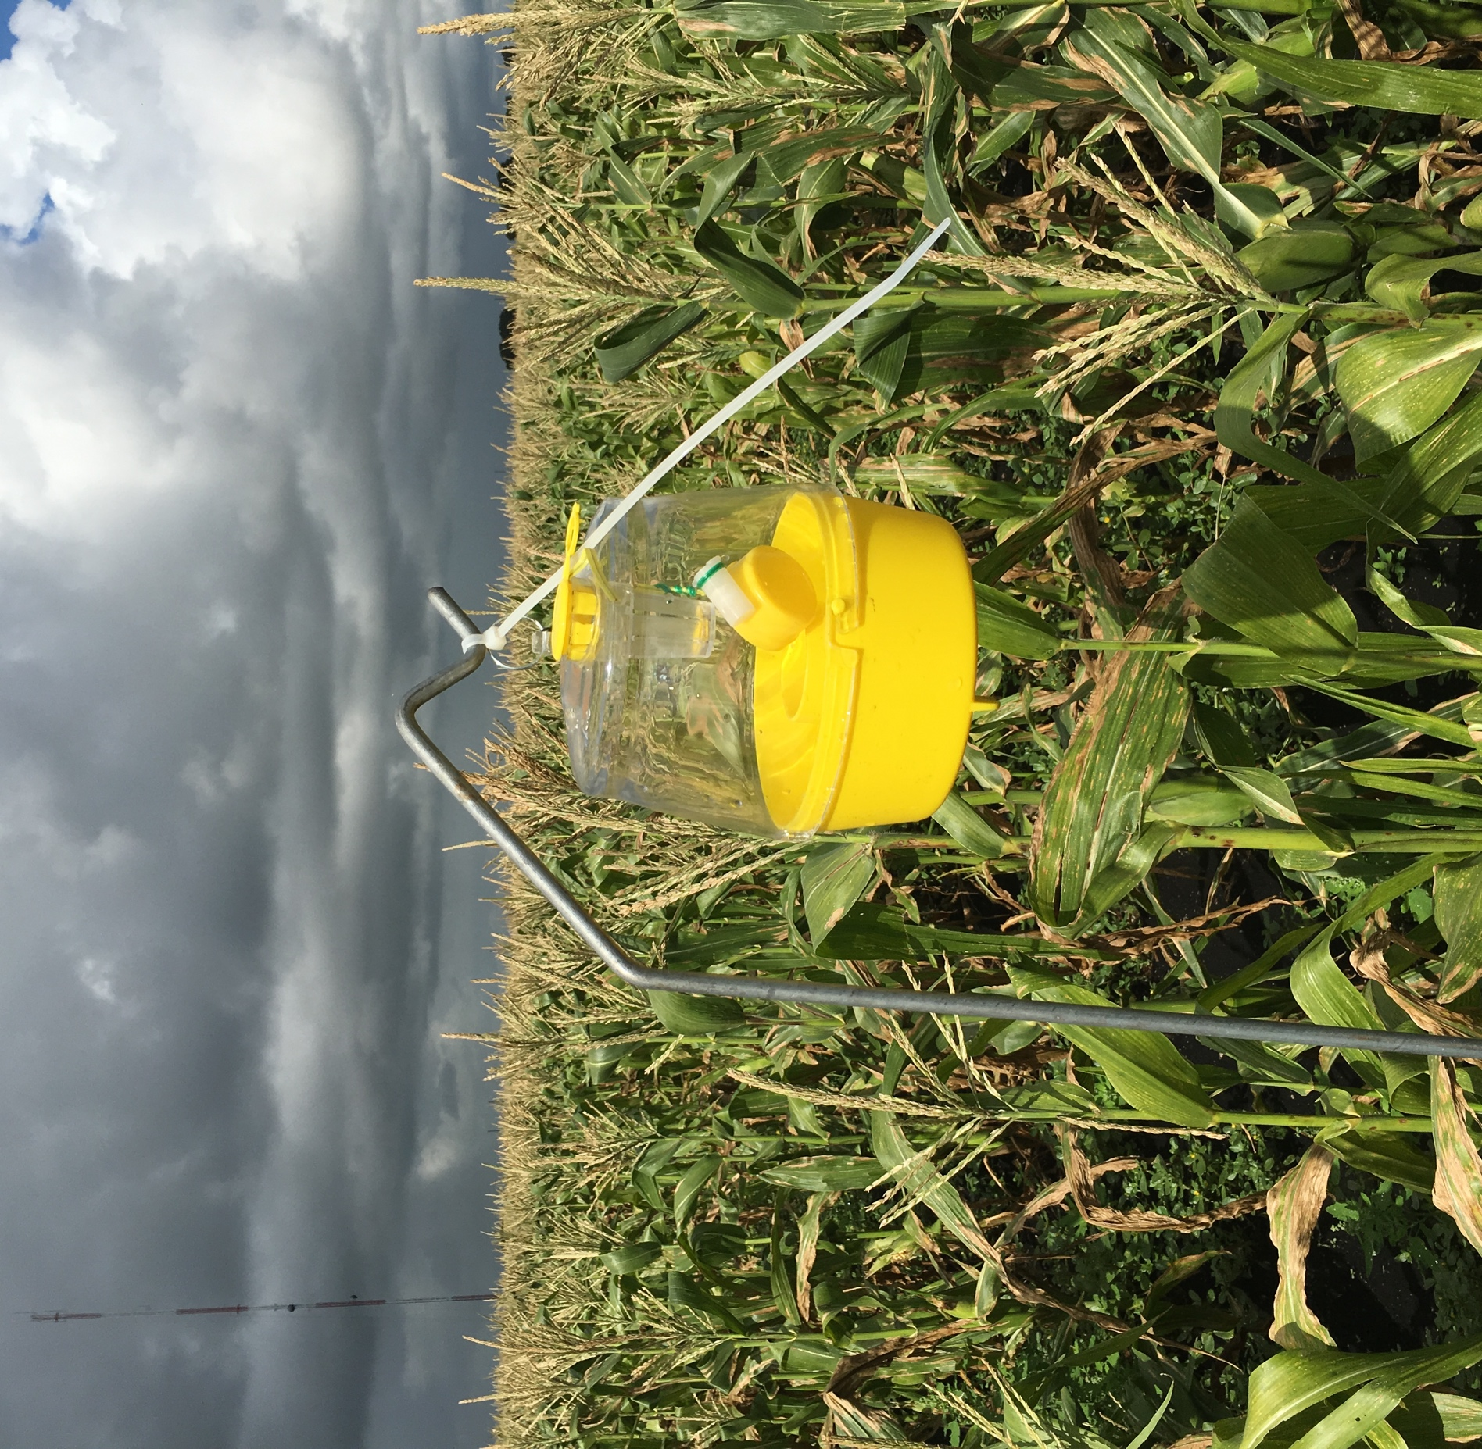
Multilure traps for corn silk fly monitoring in sweet corn, 2018-2019

Slide 25
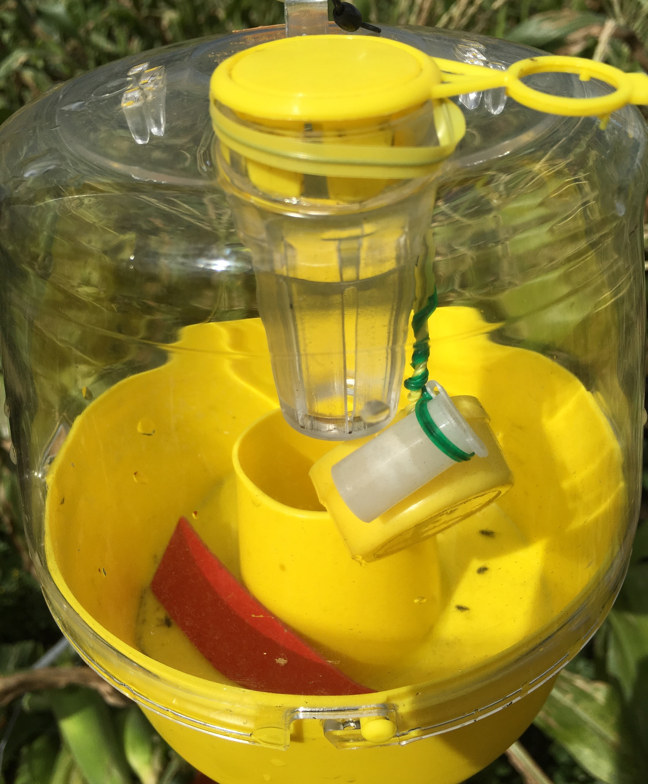
1,4 dimethoxy-benzene
Ammonium acetate

Slide 26
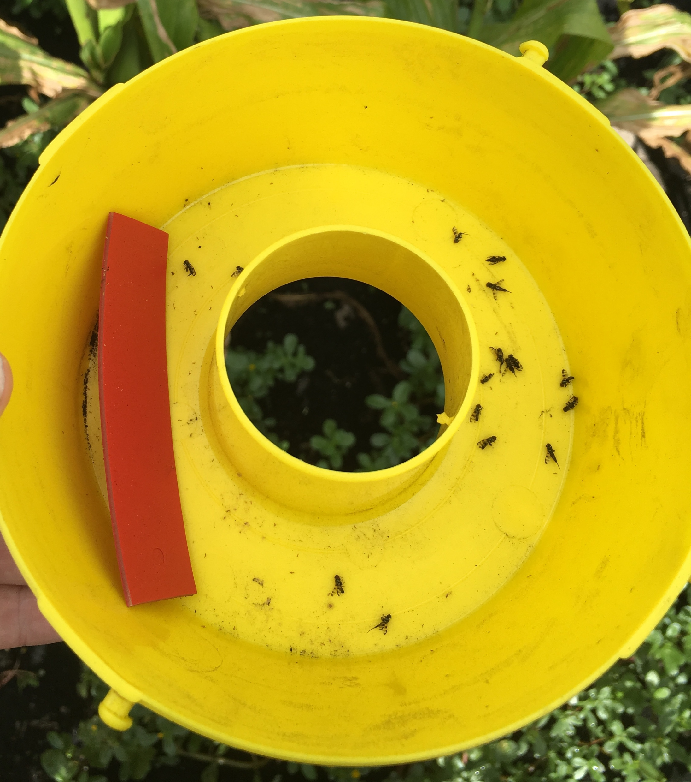

Slide 27
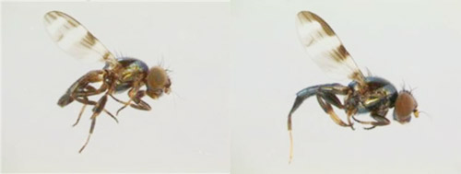
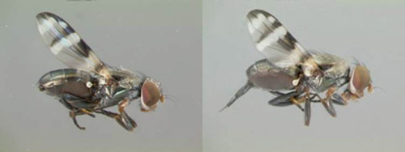
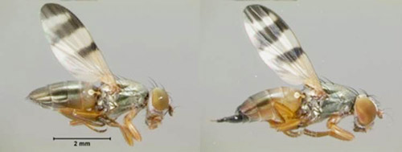
Euxesta stigmatias
Euxesta eluta
Chaetopsis massyla
Photos: Gaurav Goyal

Slide 28
Relationship between trap captures and corn silk fly observations, spring 2019
24 plots (60’ * 60’) established in a sweet corn field (480’ * 72 rows) at tassel push
Each plot
- 1 trap at the center
- 4 yellow sticky cards (3’’ * 5’’), 15’ from trap
- 2 plants adjacent to each sticky card (8 plants total)
7 samplings, every 3-4 days
4 pyrethroid applications within a week, between the 3rd and 5th samplings

Slide 29
Relationship between trap captures and sticky card observations (3 species)
Linear regression (SAS PROC REG): P < 0.001, R² = 0.302

Slide 30
Relationship between trap captures and plant observations (3 species)
Linear regression (SAS PROC REG): P < 0.001, R² = 0.313

Slide 31
Comparison of E. stigmatias observations
Insecticides
Repeated measures ANOVA (SAS PROC GLIMMIX): Sampling method P < 0.001, Date P < 0.001, Sampling method * Date P < 0.001

Slide 32
Comparison of E. eluta observations
Insecticides
Repeated measures ANOVA (SAS PROC GLIMMIX): Sampling method P < 0.001, Date P < 0.001, Sampling method * Date P < 0.001

Slide 33
Comparison of C. massyla observations
Insecticides
Repeated measures ANOVA (SAS PROC GLIMMIX): Sampling method P < 0.001, Date P < 0.001, Sampling method * Date P < 0.001

Slide 34
Conclusions: Corn silk fly management
The development of alternatives to pyrethroids is a priority and needs to continue
- Baits and biological insecticides
- Non-registered conventional insecticides
- Non-registered insect growth regulators
Traps may assist with scouting. Further work is needed to better understand the relationship between trap captures and observations in the field.

Slide 35
Acknowledgments
UF/IFAS and USDA Collaborators
Dak Seal, Sandy Allan, Gregg Nuessly
Research assistants and farm crew
Donna Larsen, Carolina Tieppo Camarozano, Annie Mills, Erik Roldán, Wilfrid Calvin, Amir Avila, Rob Ramirez, Leonard Fox, Adrian Alanis
Crop consultants
Glades Crop Care, Kevin Short
Funding
FDACS SCBGP grants 024846, 025800
USDA NIFA Hatch project 1014391
Agrochemical companies

Slide 36
Sweet Corn Silk Flies
Julien Beuzelin
Phone: 561-993-1559E-mail: jbeuzelin@ufl.edu

